Slide 1
PHPUnit & Prophecy in action

Slide 2
About me
Aleksandar Jovanovic
Jovanovic.aleksandar.83@gmail.com
I work at Nano Interactive
I've worked with (and wrote tests in) PHP for 4+ years
I strongly believe that testing is necessary part of every non-trivial application
https://github.com/ajant

Slide 3
Goals of the talk are
I'm here to share my experiences regarding testing
To give you an example of how to organize and write tests
To show features of Prophecy – library for unit testing

Slide 4
Goals of the talk are not
To show all the features of PHPUnit & Prophecy, there are way too many, you'll have to explore them on your own
To demonstrate working with database, as it doesn't fall into Unit testing

Slide 5
Disclaimer 1
This is the system created by developers and for developers
No professional QA engineers were consulted during creation of this solution (and thus none were hurt)
This is not “the ultimate” architecture by any means. This is something that works for us, but also something we are tweaking and improving on regular basis

Slide 6
Disclaimer 2
Code included into this talk can be found here: TestingDemonstration
It was made to be lorem-ipsum like as much as possible, it was designed to allow demonstration of PHPUnit features and most of it is probably complete jiberish as far as usability goes. But all features demonstrated by this slightly cartoonish code are actually very useful and most of them are essential for any non-trivial project testing

Slide 7
Overview
Why test?
Types of tests
One way to organize unit tests
PHPUnit
Prophecy

Slide 8
Why test? - Pros
Tests reduce number of bugs
Tests make serious refactoring less scary
TDD – popular approach to development
Tests add to documentation
Writing tests helps developers become better at their craft (especially beginners)
It's easy

Slide 9
Why test? - Cons
It takes time (though it doesn' have to take too much time, if well thought out)
It's impossible (or better yet impractical) to write tests that cover all eventualities and guarantee code correctness
There is no ultimate testing solution, but rather a number of different approaches
Tests are code and code has to be maintained

Slide 10
Overview
Why test?
Types of tests
One way to organize unit tests
PHPUnit
Prophecy

Slide 11
Types of tests – What everyone agrees on
Nothing
http://stackoverflow.com/questions/4904096/whats-the-difference-between-unit-functional-acceptance-and-integration-test
“The important thing is that you know what those terms mean to your colleagues. Different groups will have slightly varying definitions of what they mean...”

Slide 12
Types of tests – The way we use them
Unit
Integration
End to end
Acceptance

Slide 13
Types of tests – Unit test
“Tests the smallest unit of functionality, typically a method/function (e.g. given a class with a particular state, calling x method on the class should cause y to happen)”

Slide 14
Overview
Why test?
Types of tests
One way to organize unit tests
PHPUnit
Prophecy

Slide 15
One way to organize unit tests – Principles
When writing tests, always keep in mind why they are being written in the first place
Unit tests should be helpers, they should not introduce complexity into code
They should follow KISS principle
Above all they should be easy to read and understand
Loops and conditions should be avoided if possible

Slide 16
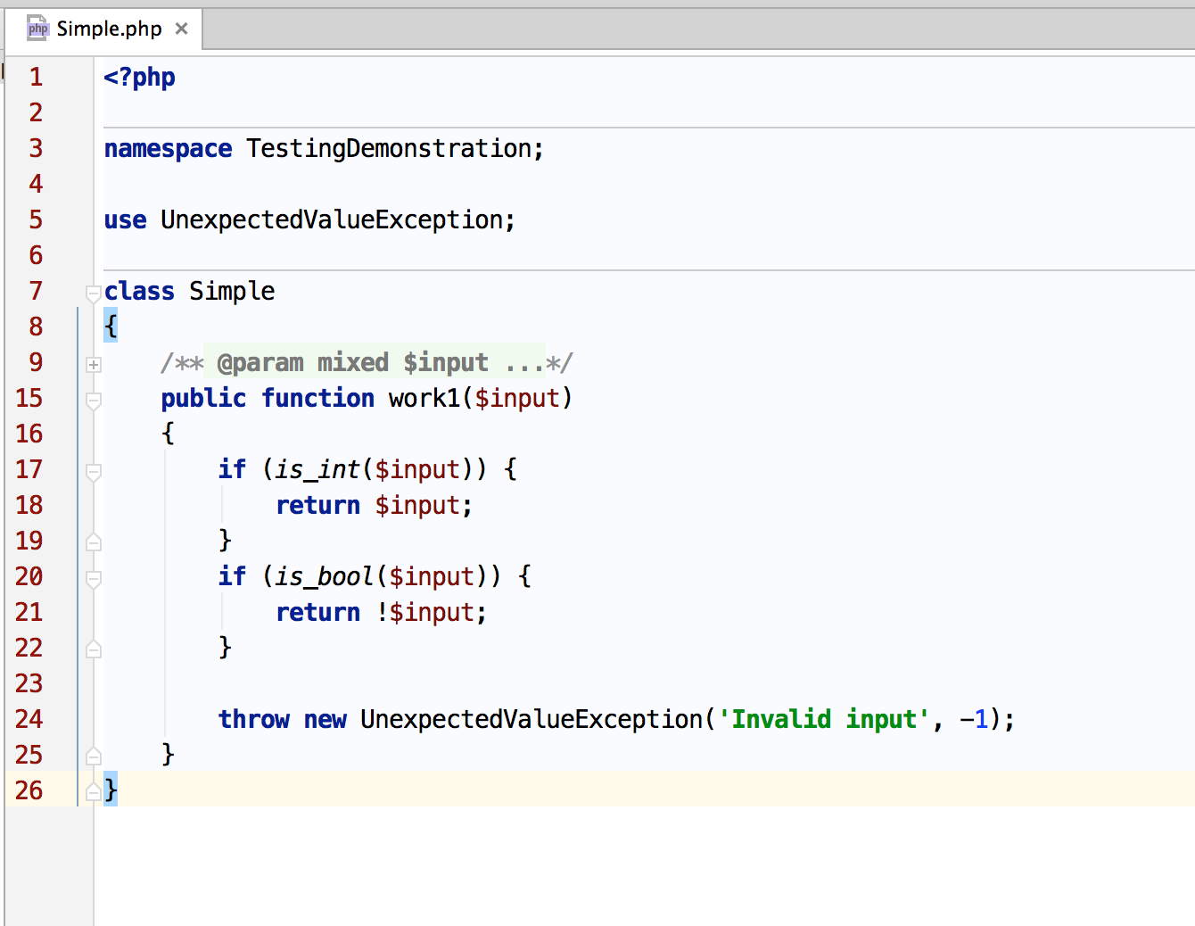
One way to organize unit tests – What we are testing

Slide 17
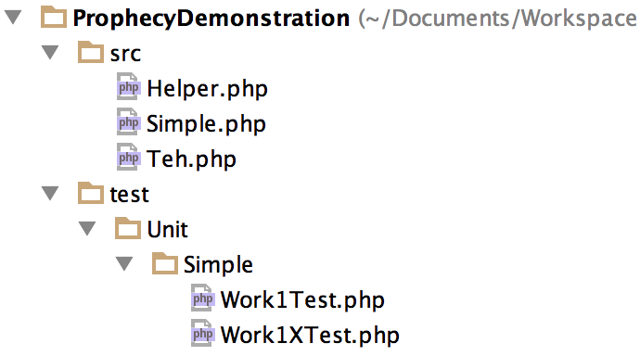
One way to organize unit tests – Structure

Slide 18
Overview
Why test?
Types of tests
One way to organize unit tests
PHPUnit
Prophecy

Slide 19
PHPUnit – The PHP Testing Framework
https://phpunit.de/
Authored by Sebastian Bergmann
One of, if not the, most popular PHP testing frameworks
Also perfectly suited to being used for other kinds of tests other then unit
Install via composer - my preferred way (PEAR & phar are also options)

Slide 20
PHPUnit – Alternatives
PhpSpec
Behat
Codeception

Slide 21
PHPUnit – Simple example
<?php
namespace TestingDemonstration\Test\Unit;
use PHPUnit_Framework_TestCase;
use TestingDemonstration\Simple;
class Work1Test extends PHPUnit_Framework_TestCase
{
public function testBool()
{
// arrange
$input = true;
$expected = false;
$simple = new Simple();
// act
$result = $simple->work1($input);
// assert
$this->assertEquals($expected, $result);
}
}

Slide 22
PHPUnit – Test code structure
Act – invoke logic which is being tested
Assert – PHPUnit assertions
Arrange – Everything else, preparation for logic invocation, preparation for assertions, etc.
Test method must either start with word test or have @test annotation

Slide 23
PHPUnit – Running from command line
./vendor/bin/phpunit test/Unit/Simple/
One or more files can be run during one test suit run

Slide 24
PHPUnit – Assertions 1
assertEquals($expected, $actual)
assertTrue($actual)
assertContains($needle, $haystack)
Many others: https://phpunit.de/manual/current/en/appendixes.assertions.html
Assertions are static methods and can be used outside of testing context (for example for validation), but author recommends, when testing, they be used from within class context, as shown in example above

Slide 25
PHPUnit – Data provider
@dataProvider dataProviderMethod
Is used to run same test code for different sets of input while expecting appropriate output, without having to repeat the test code (think “for” loop)
It's very important to provide a short explanation: why test case is needed (#0 input bool)

Slide 26
PHPUnit – Data provider example
/**
* @dataProvider getData
*/
public function testMethod($input, $expected)
{
// arrange
$simple = new Simple();
// act
$result = $simple->work1($input);
// assert
$this->assertEquals($expected, $result);
}
public function getData()
{
return [
#0 input type: integer
[
'input' => true,
'expected' => false
],
#1 input type: bool
[
11,
11
],
];
}

Slide 27
PHPUnit - setUp
Method setUp can be used to prepare environment for the test
Most often used to write test data into test database before the test is run

Slide 28
PHPUnit - tearDown
Method tearDown can be used to clean up environment after the test
Most often used to remove test data from test database after the test is run

Slide 29
PHPUnit – Assertions 2
More then one assertion can be used in one test
When first assertion fails, test fails and execution is stopped
When a test fails, tearDown method is still run
If test was run via data provider, next test case is executed

Slide 30
PHPUnit - Bootstrap
Test suit can be configured using -c option and configuration XML file
Certain actions might need to be performed before test suit is run
This can be achieved by directing configuration file to run bootstrapping script before any tests are ran

Slide 31
PHPUnit – phpunit.xml
<!DOCTYPE phpunit>
<phpunit bootstrap="./bootstrap.php" colors="true">
<testsuite name="All Tests">
<directory>.</directory>
</testsuite>
<filter>
<whitelist>
<directory suffix=".php">./</directory>
</whitelist>
</filter>
</phpunit>

Slide 32
PHPUnit – Order of execution 1
Bootstrap script
All data providers
setUp for the test being run
Test being run
tearDown for the test being run

Slide 33
PHPUnit – Order of execution 2
It can be observed that test files are executed by the alphabet order, but the framework does not guarantee it, so your tests should not depend on it
Test should be completely independent and should pass or fail in the same way, regardless of whether jus one test is run or a bunch of them

Slide 34
PHPUnit – Exceptions
The most important thing is that exception needs to be announced, before it's thrown (assert has to happen before act)
setExpectedException
To be deprecated in upcoming PHPUnit versions

Slide 35
PHPUnit – Exceptions, example
<?php
namespace TestingDemonstration\Test\Unit;
use PHPUnit_Framework_TestCase;
use TestingDemonstration\Simple;
class Work1XTest extends PHPUnit_Framework_TestCase
{
/**
* @dataProvider getData
*/
public function testInvalidInput($input)
{
// assert
$this->setExpectedException(
'\UnexpectedValueException',
'Invalid input',
-1
);
// arrange
$simple = new Simple();
// act
$simple->work1($input);
}
public function getData()
{
return [
#0 input type: integer
[
'input' => [],
],
#1 input type: bool
[
'input' => 'foo'
],
];
}
}

Slide 36
PHPUnit - CustomTestCase
Test classes are classes like all others
DRY principle should be followed when possible
Don't overdo DRY though, KISS is more important long term, if you have to choose between them

Slide 37
PHPUnit – Code coverage
--coverage-text
Code coverage can be exported into a file using different formats (XML, HTML...)
Can be configured using configuration file

Slide 38
PHPUnit – When is it enough?
One of the hardest and most important decisions: when is it enough?
No universal solution to the problem
Code coverage is useful, but potentially misleading
In the end it should depend on the amount of time you can afford for testing and the importance of the tested unit of code

Slide 39
Overview
Why test?
Types of tests
One way to organize unit tests
PHPUnit
Prophecy

Slide 40
Prophecy - Overview
https://github.com/phpspec/prophecy
Highly opinionated mocking framework for PHP 5.3+
Works best with IoC pattern

Slide 41
Prophecy - Alternatives
Mockery is very similar in features and use cases
Better then Prophecy in that it uses fluent interface approach and thus gives you auto-complete
Worse then Prophecy in that stable version has not been released yet
Prophecy is integrated with PHPUnit

Slide 42
Prophecy - Types of prophecy objects
Mocks, stubs, dummies...

Slide 43
Prophecy - Dummy
“Dummy objects are objects that extend and/or implement preset classes/interfaces by overriding all their public methods. The key point about dummies is that they do not hold any logic - they just do nothing.”

Slide 44
Prophecy - Stub
“A stub is an object double, which doesn't have any expectations about the object behavior, but when put in specific environment, behaves in specific way ... Simply put, a stub is a dummy, which depending on the called method signature does different things (has logic).”

Slide 45
Prophecy - Mock
“What's left is doubles for which we have some expectations. These are called mocks and in Prophecy they look almost exactly the same as stubs, except that they define predictions “

Slide 46
Prophecy – prophesize() & reveal() (dummy)
class Teh
{ //...
public function __construct(Helper $helper)
{
$this->helper = $helper;
}
//...
class TehTestCase extends PHPUnit_Framework_TestCase
{ //...
$this->prophetHelper = $this->prophesize('TestingDemonstration\Helper');
$this->teh = new Teh($this->prophetHelper->reveal());
//...

Slide 47
Prophecy – will... (stub)
willReturn
willThrow
will(callback)

Slide 48
Prophecy – should be called (mock)
shouldBeCalled()
shouldBeCalledTimes()

Slide 49
Prophecy – Argument
When several calls are made to the same method with different argument, prophecy matches each call to the arguments defined when predicting behavior
Prophecy\Argument class can be used to avoid matching exact argument value

Slide 50
Prophecy - Assertions
When prophecy is used to create doubles, there is no assertions if doubles are not mocks (one or more of the should be called methods is called)

Slide 51
Thank you
Questions?

